Slide 1
Review 3
Yuhsiang (Sean) Hong

Slide 2
Strategy
For each hyperparameter combination,
Use 3-fold cross-validation for each dataset
Calculate the average of test RMSE among 3 folds
Calculate the mean of all the average test RMSE among 15 QSAR training datasets
Return all the mean of RMSE from each hyperparameter combination and then select the smallest one as my optimal result
Construct the model from QSAR train datasets using the optimal hyperparameter combination, and test it on QSAR test datasets

Slide 3
Tune One Hyperparameter

Slide 4
Tune One Hyperparameter - Random Forest
Hyperparameter | Best Value | Mean of RMSE
default | -- | 1.9652
n_estimators | 800 | 1.9503
bootstrap | False | 1.9184
max_samples | 1.0 (default) | 1.9657
max_features | 0.5 | 1.9288
min_samples_leaf | 1 (default) | 1.9635

Slide 5
Tune One Hyperparameter - XGBoost
Hyperparameter | Best Value | Mean of RMSE
default | -- | 2.0738
num_boost_round | 100 | 1.9442
lambda | 0.125 | 2.0684
alpha | 1.0 | 2.0574
eta | 0.4 | 2.0520
subsample | 1.0 | 2.0738
max_depth | 7 | 2.0505
min_child_weight | 4 | 2.0600
colsample_bytree | 0.8 | 2.0586
colsample_bylevel | 0.8 | 2.0718

Slide 6
Tune One Hyperparameter - Conclusion
Random Forest:
“bootstrap” = False > “bootstrap” = True
“max_features” is worth tuning
XGBoost:
For QSAR datasets, it takes over an hour to tune one hyperparameter combination with “num_boost_round” equal to 100
“num_boost_round” is worth tuning, but it is also the most time-consuming to tune
Tuning “eta” and “max_depth” also shows some improvement comparing to other hyperparameters

Slide 7
Tune All Hyperparameters
- Grid Search
- Random Search
- Bayesian Optimization

Slide 8
Tune All Hyperparameters
Random Forest
Grid Search : 144 points
Random Search: Randomly select 50 points from 6655 grid points
Bayesian Optimization: Do 50 trails from 6655 grid points
Difficulty:
Cannot set min_samples_leaf = 1 because of the large execution time
Choose a smaller search space for Grid Search
XGBoost
Grid Search : 108 points
Random Search: Randomly select 50 points from 5821200000 grid points
Bayesian Optimization: Do 50 trails from 5821200000 grid points
Difficulty:
Cannot tune “num_boost_round” in Grid Search
Only tune “eta”, “max_depth”, and “min_child_weight” in Grid Search

Slide 9
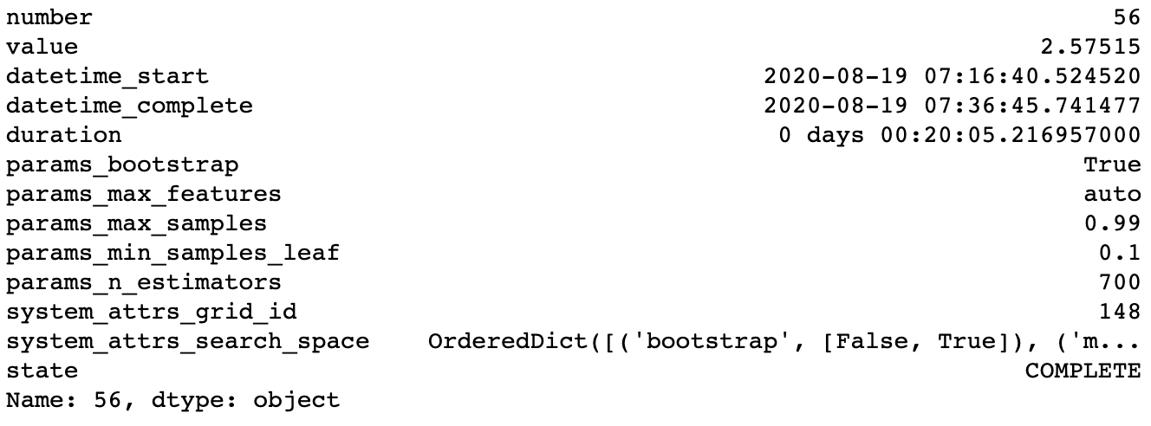
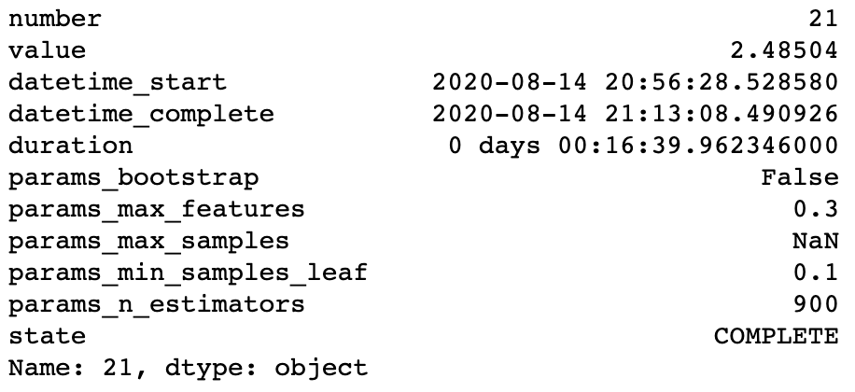
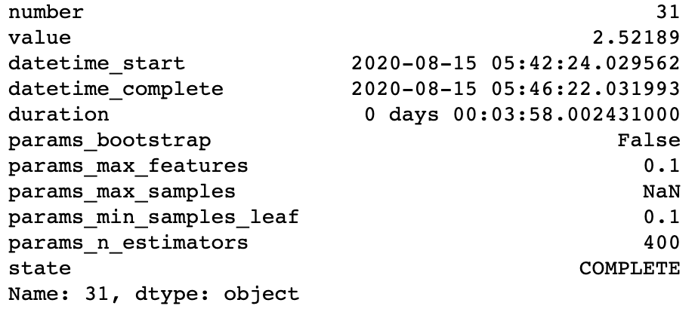
Random Forest
Grid Search
Bayesian Optimization
Random Search

Slide 10
Random Forest
Training Datasets
Method | RMSE (Default: 2.9241) | Improvement Rate (percentage) | Execution Time (hour : minute)
Grid Search | 2.5751 | 11.94% | 12 : 29
Random Search | 2.5219 | 13.75% | 4 : 06
Bayesian Optimization | 2.4850 | 15.02% | 8 : 53
Testing Datasets
Method | RMSE (Default: 3.2153) | Improvement Rate (percentage)
Grid Search | 2.9470 | 8.35%
Random Search | 2.8782 | 10.48%
Bayesian Optimization | 2.8665 | 10.85%

Slide 11
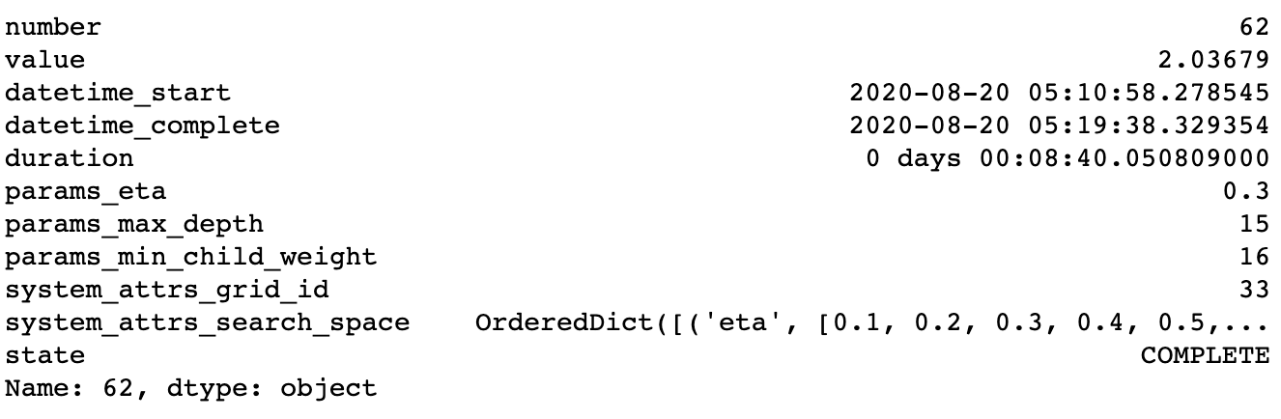
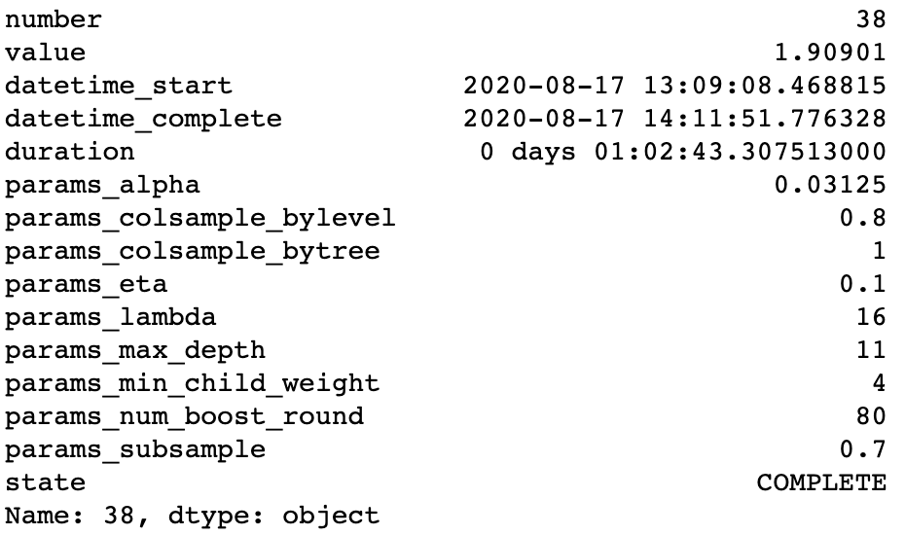
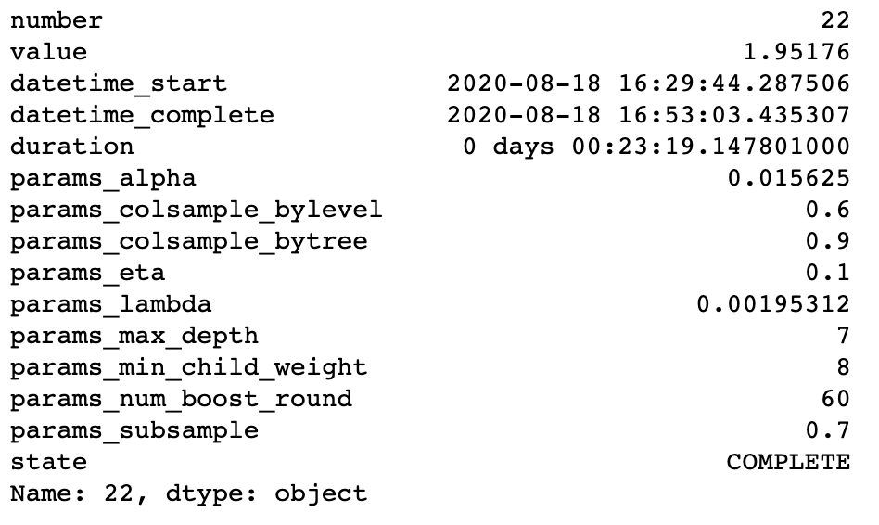
XGBoost
Grid Search
Bayesian Optimization
Random Search

Slide 12
XGBoost
Training Datasets
Method | RMSE (Default:2.0738) | Improvement Rate (percentage) | Execution Time (hour : minute)
Grid Search | 2.0368 | 1.78 % | 14 : 06
Random Search | 1.9518 | 5.88 % | 18 : 52
Bayesian Optimization | 1.9090 | 7.95 % | 23 : 28
Testing Datasets
Method | RMSE (Default: 2.5955) | Improvement Rate (percentage)
Grid Search | 2.5527 | 1.65%
Random Search | 2.3938 | 7.77%
Bayesian Optimization | 2.4705 | 4.82%

Slide 13
Conclusion & Recommendation
Improvement: Bayesian Optimization = Random Search > Grid Search
Time efficiency: Random Search > Bayesian Optimization > Grid Search
Grid Search can be used if we have some deep knowledge in the specific Machine Learning algorithms and datasets
Random Search does not guarantee to have some improvement to the model
In general, Bayesian Optimization can get the result that improve the model, but it needs more execution time than Random Search
Software recommendation: Python (Jupyter Notebook)
Package recommendation: Optuna
Easy of use and API
Can run Grid Search, Random Search, and Bayesian Optimization
There is a proper webpage that explains all the basic concepts and shows you where to find more information.

Slide 14
Thank You!

